Slide 1
Final Presentation
Jingmin Chen, Tianyu Sun

Slide 2
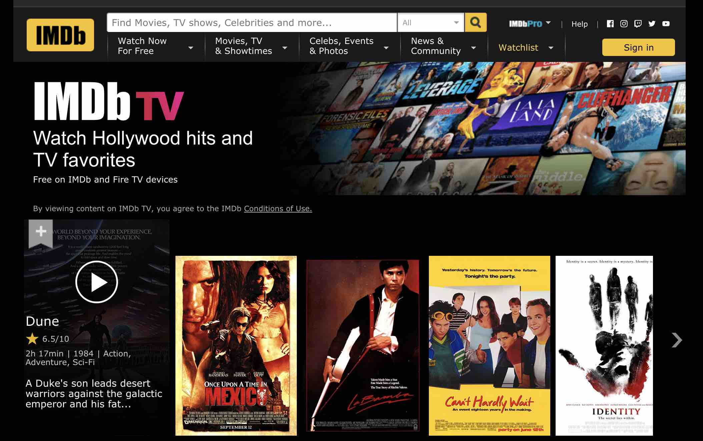
Introduction

Slide 3
Research Questions
. In this project, we will build a movie grading model based on a large amount of movie data. Based on the existing movie data, we will predict the IMDB score of the movie.
Establishing a movie ratings forecasting system is of great significance to the expected box office of movies

Slide 4
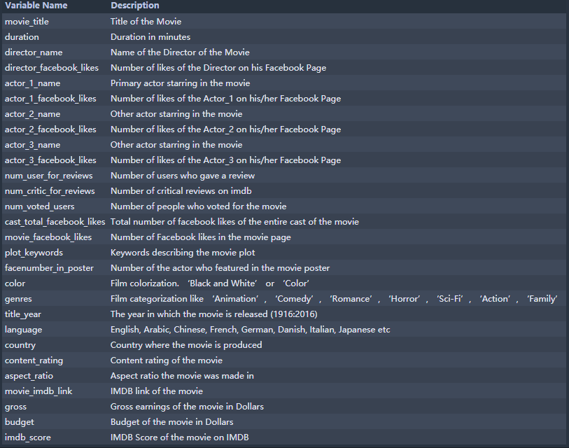
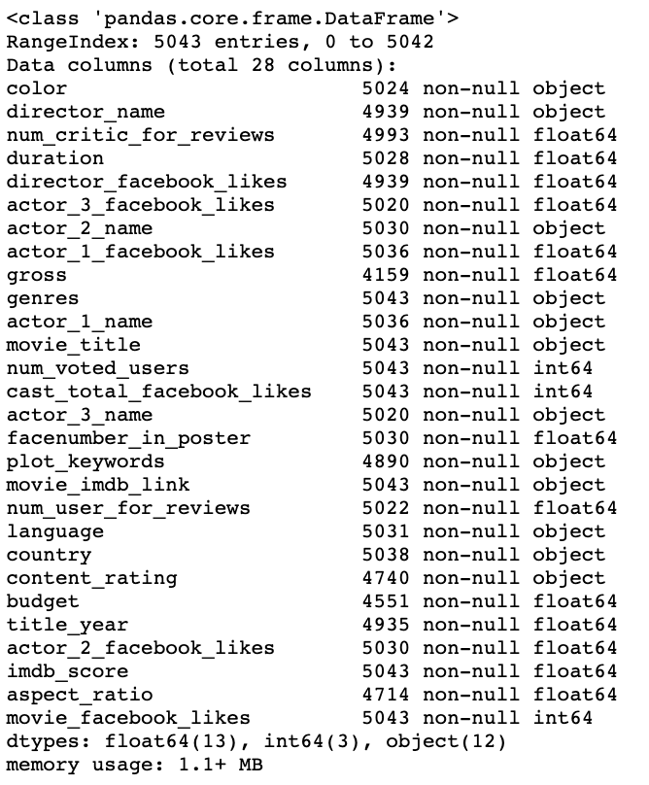
Data Info

Slide 5
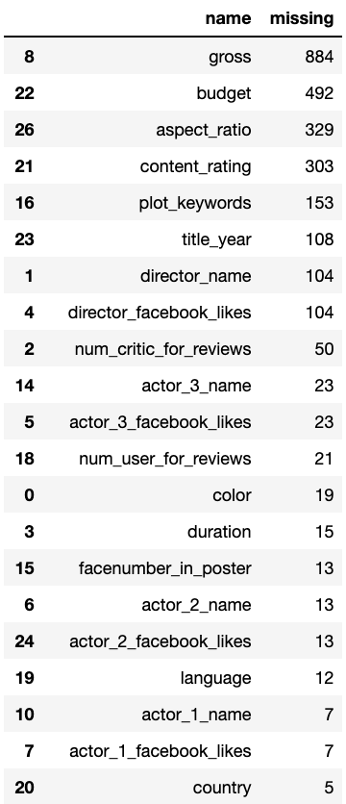
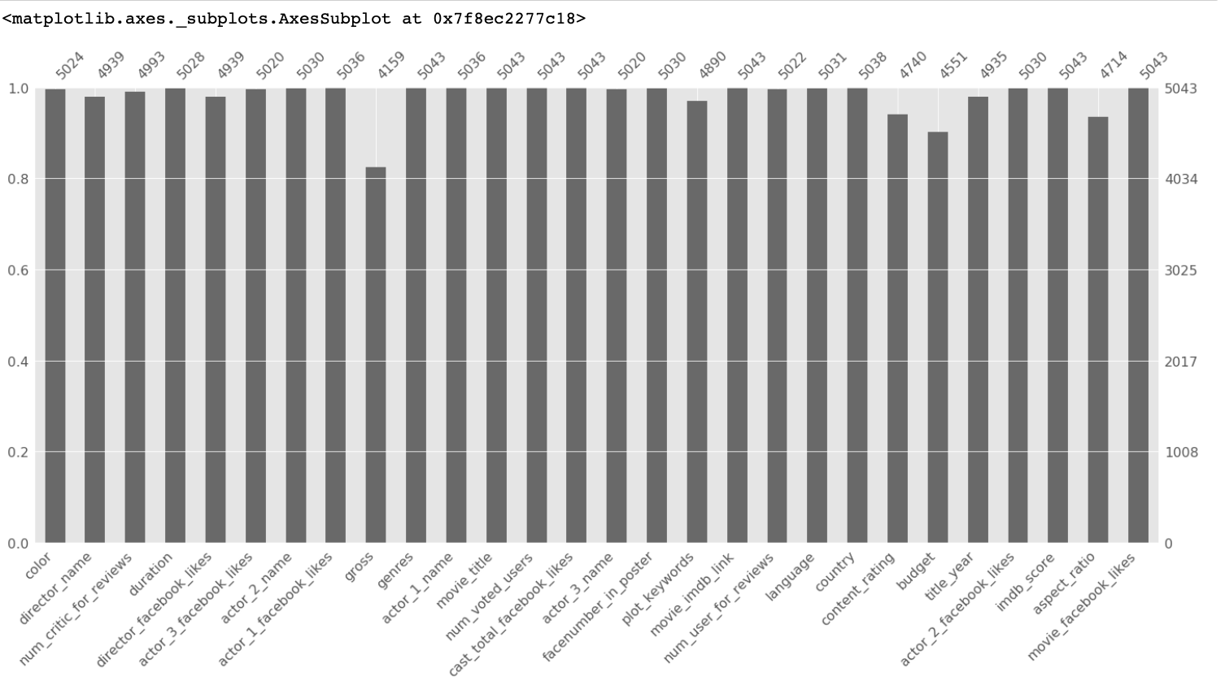
Missing data

Slide 6
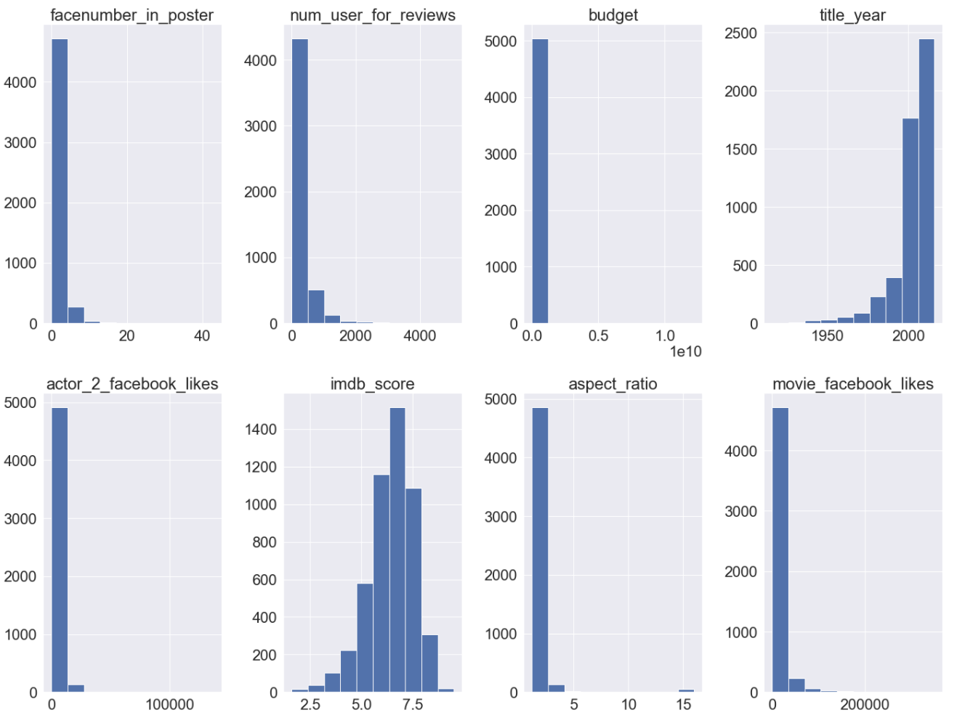
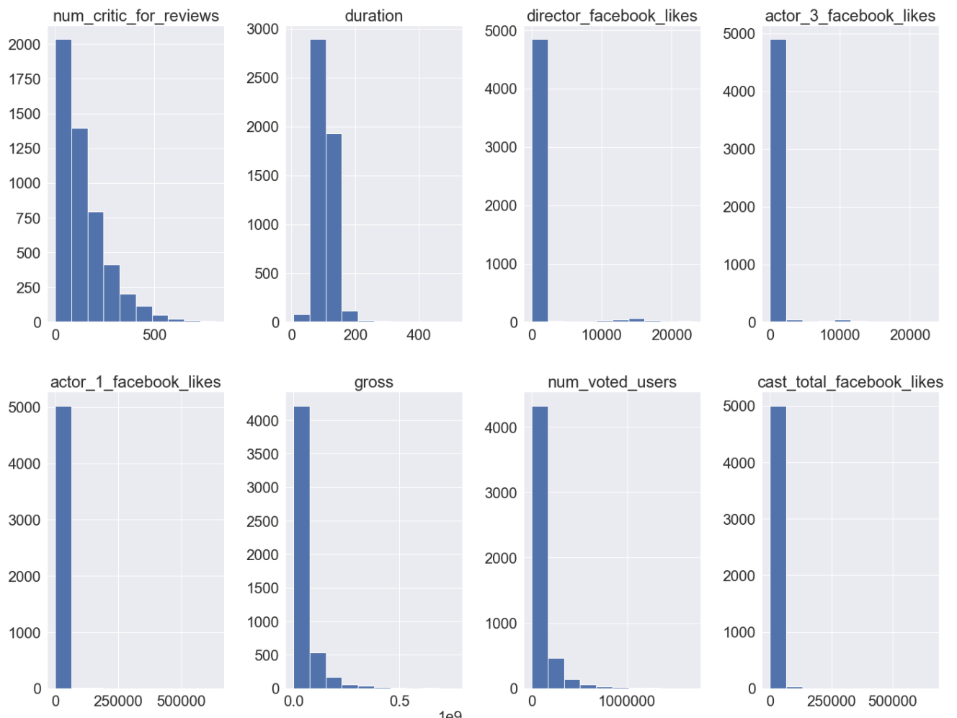
EDA for numerical data

Slide 7
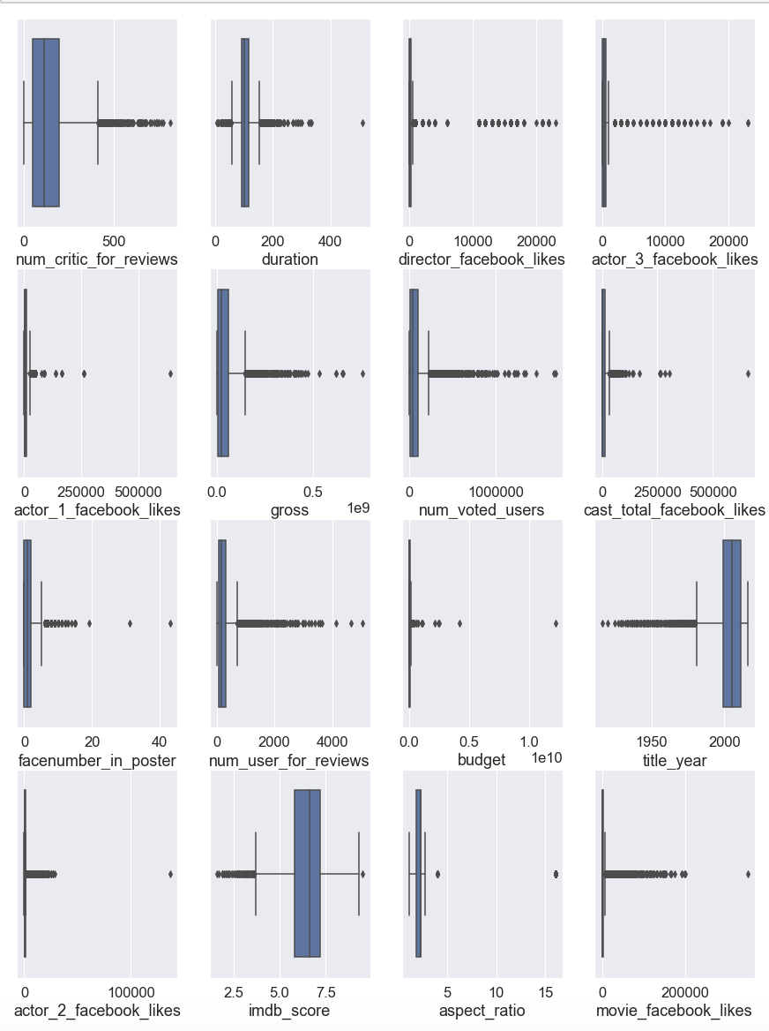

Slide 8
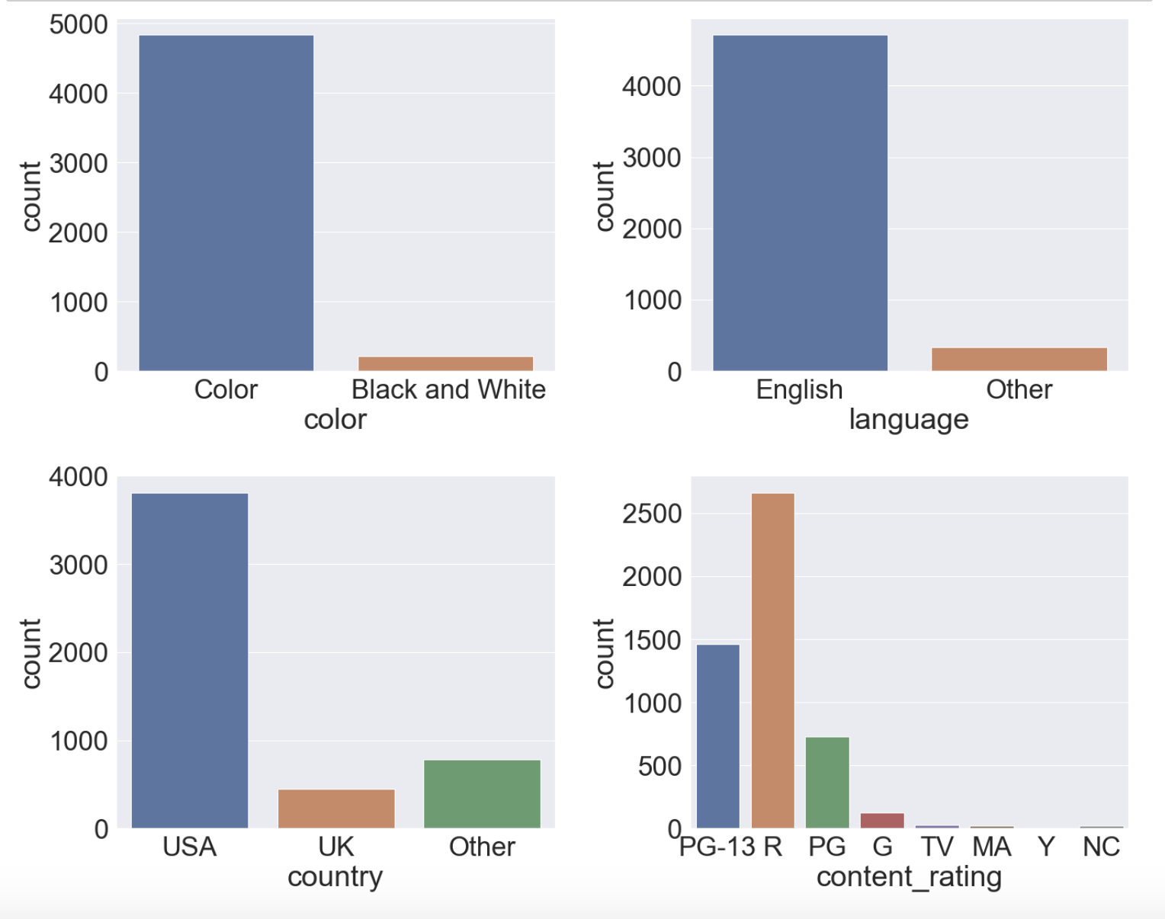
EDA for categorical data

Slide 9
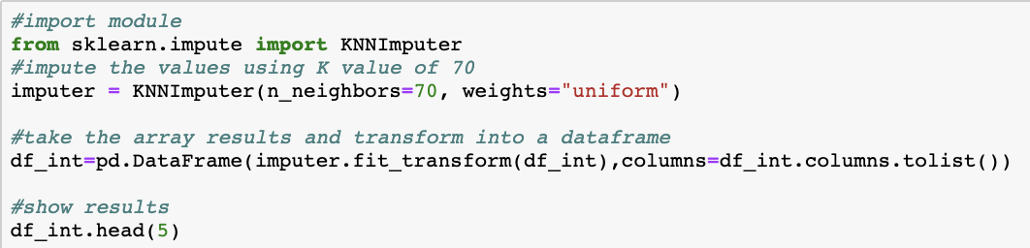
Use KNNImputer to fill the missing numerical data
For categorical features, we use the mode to fill in missing values

Slide 10
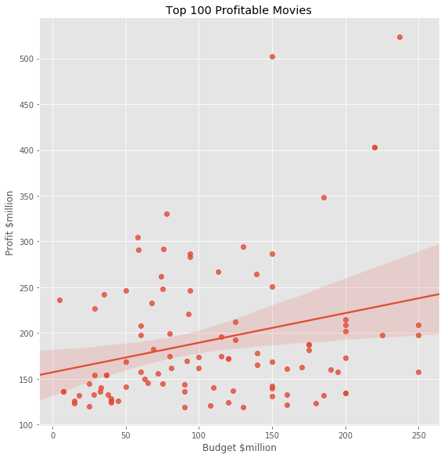
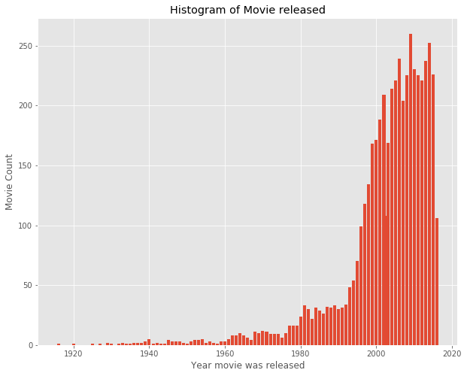
Data Visualization
dt['profit'] = dt['gross'] - dt['budget']

Slide 11
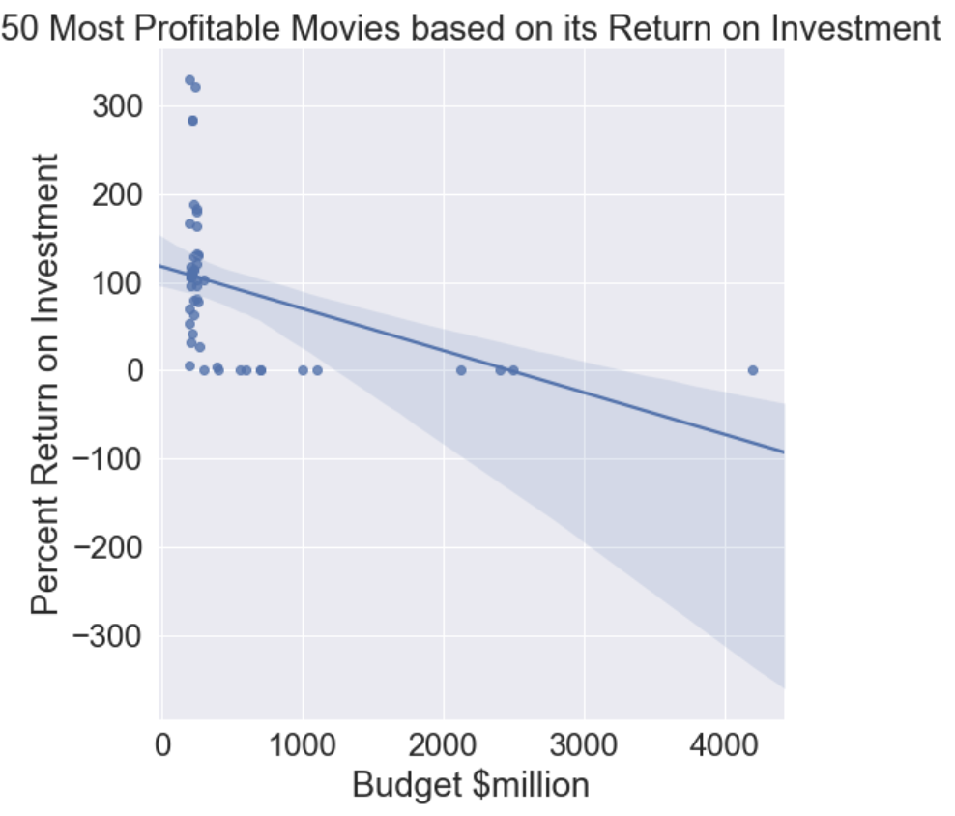
Data Visualization
dt['return_on_investment_perc'] = (dt['gross'] / dt['budget']) * 100

Slide 12
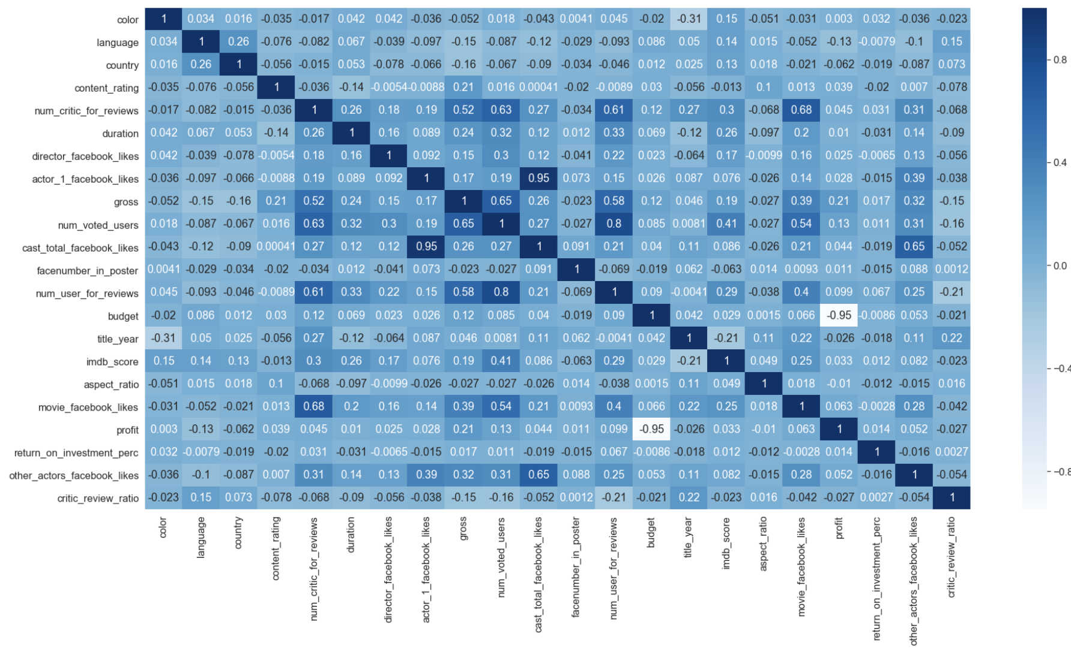
Heat Map

Slide 13
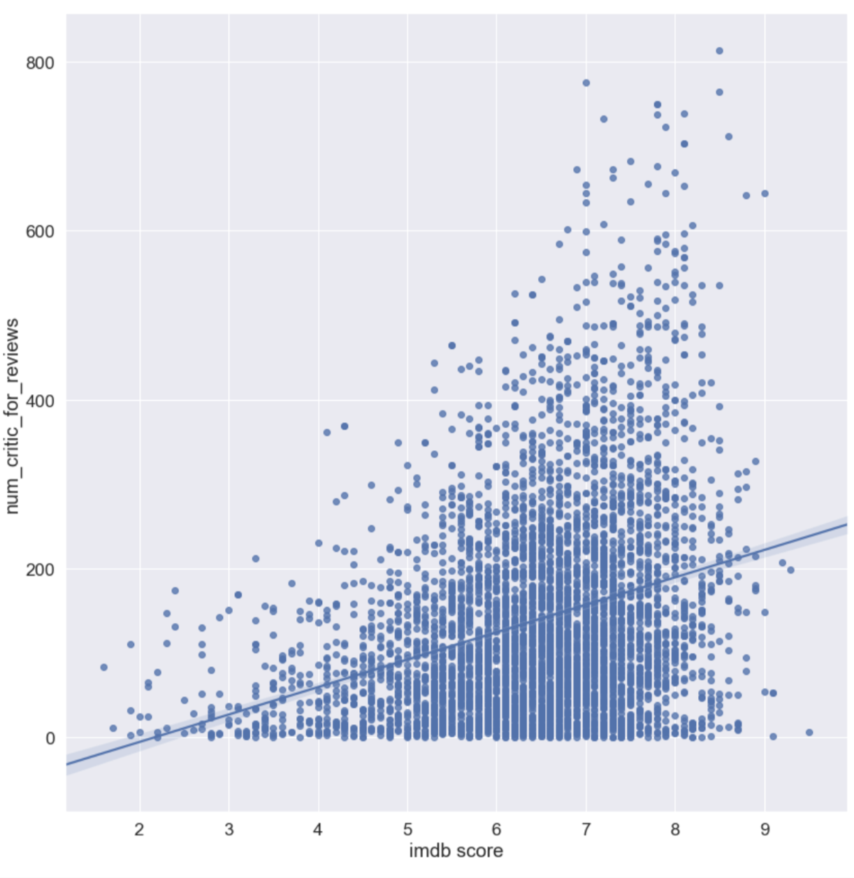
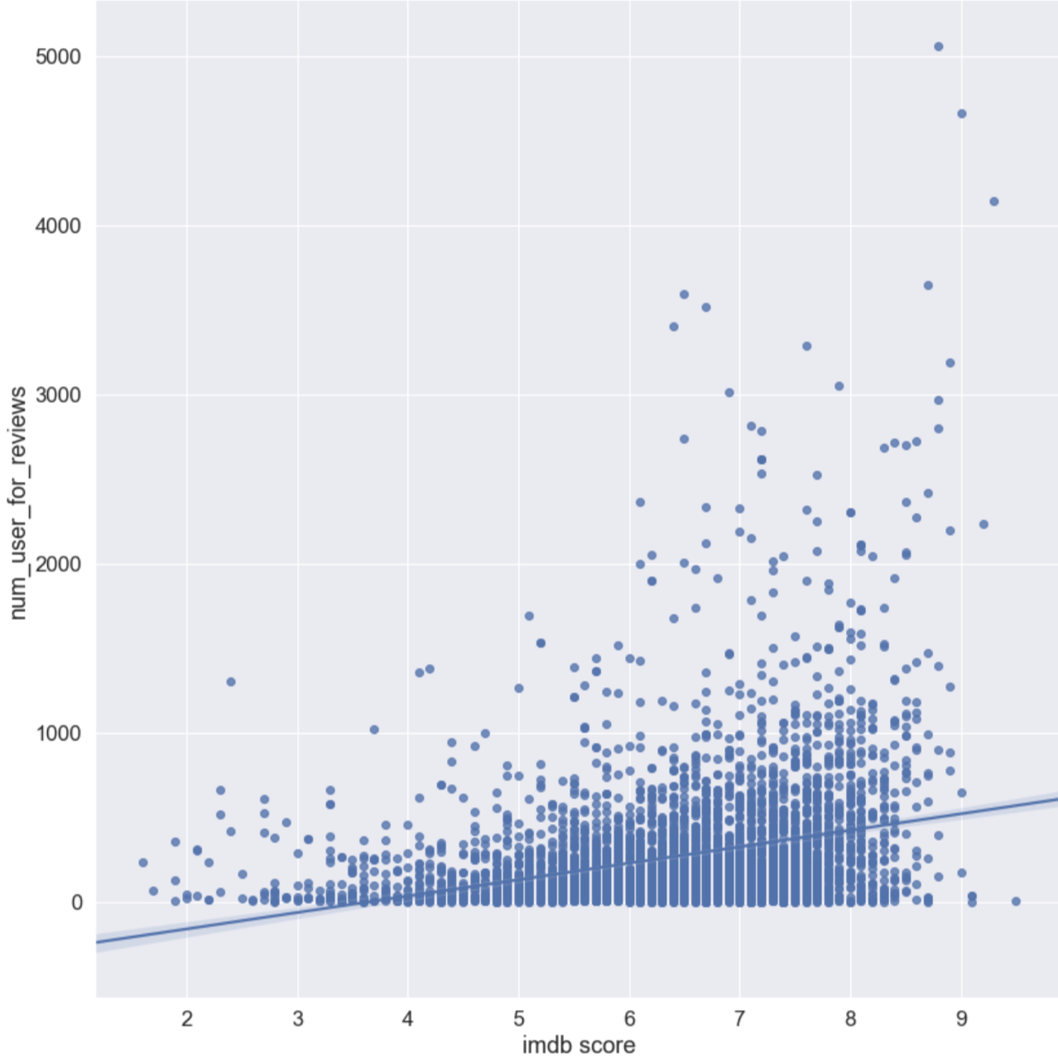
dt['critic_review_ratio'] = dt['num_critic_for_reviews'] / dt['num_user_for_reviews']

Slide 14
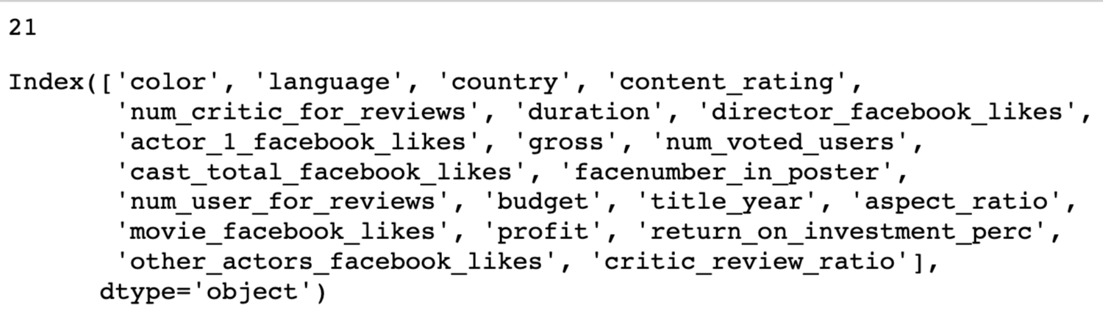
Feature selection

Slide 15
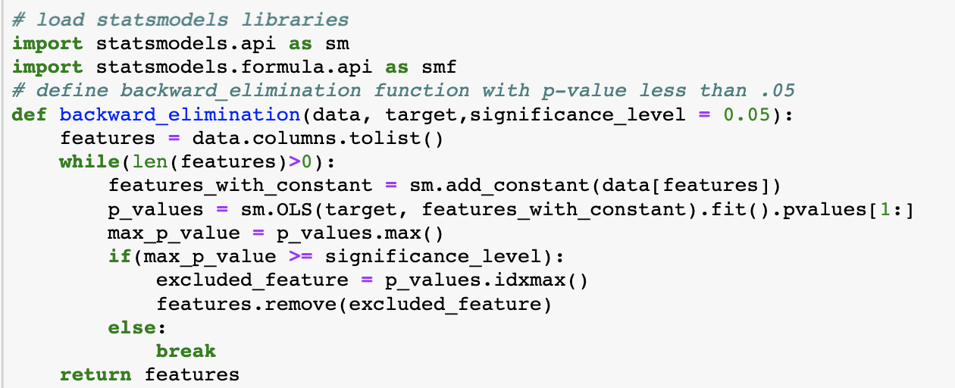
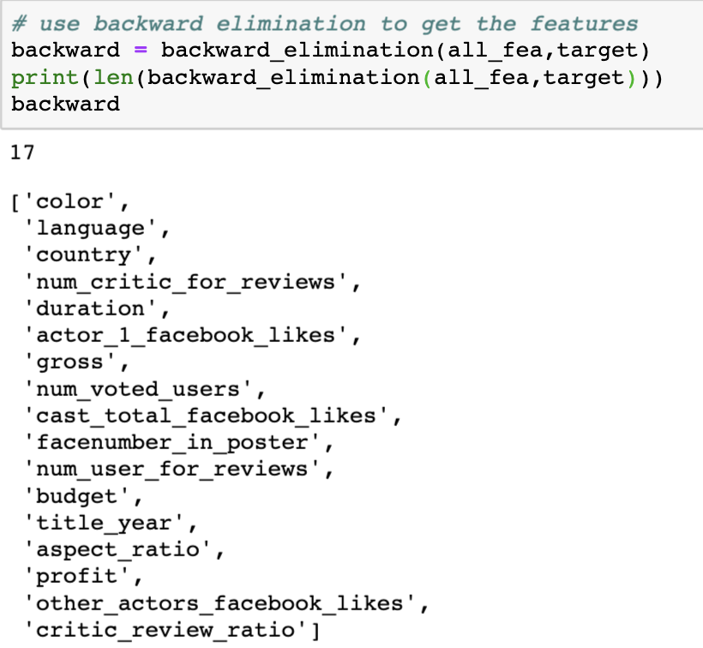

Slide 16
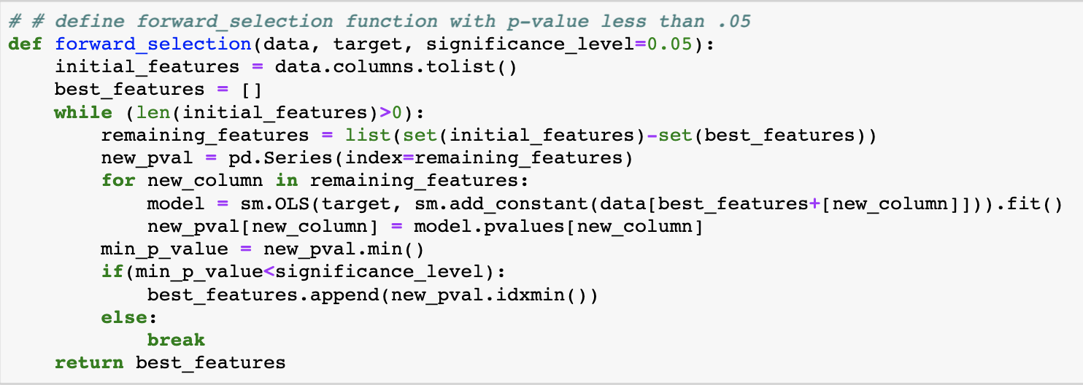
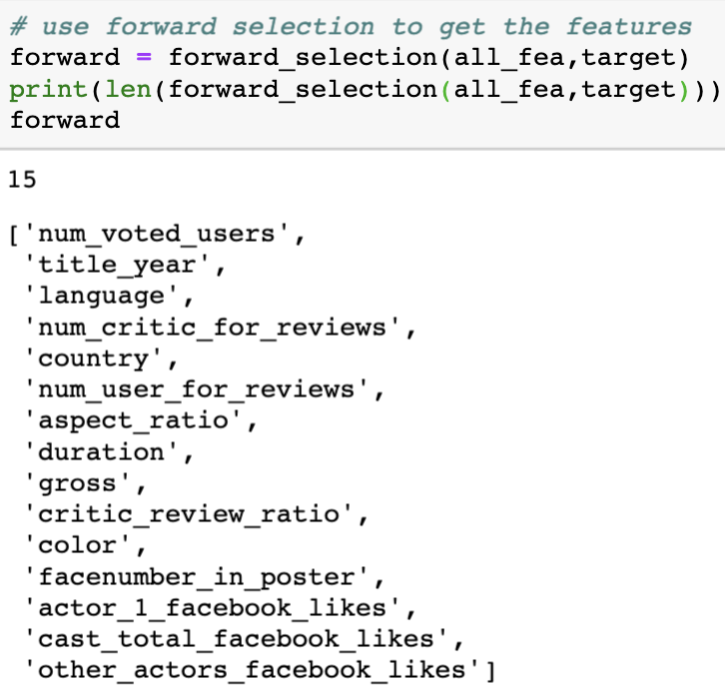

Slide 17
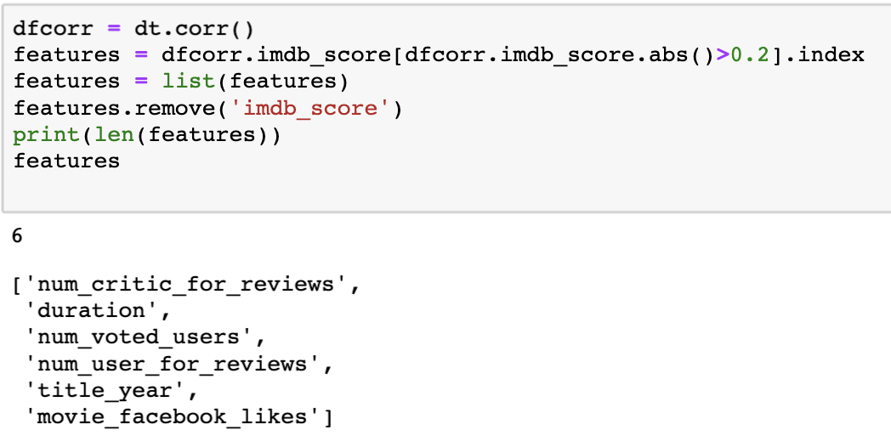

Slide 18
Metrics
rmse
def rmse(y_true,y_test):
return np.sqrt(mean_squared_error(y_true,y_test))
r^2

Slide 19
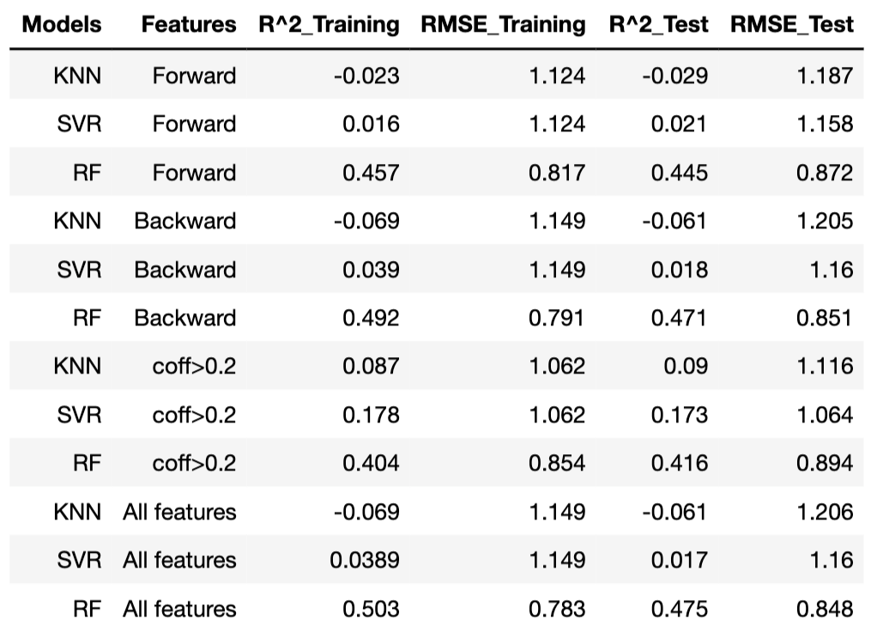
Modeling
KNN:
SVR:
Random Forest:

Slide 20
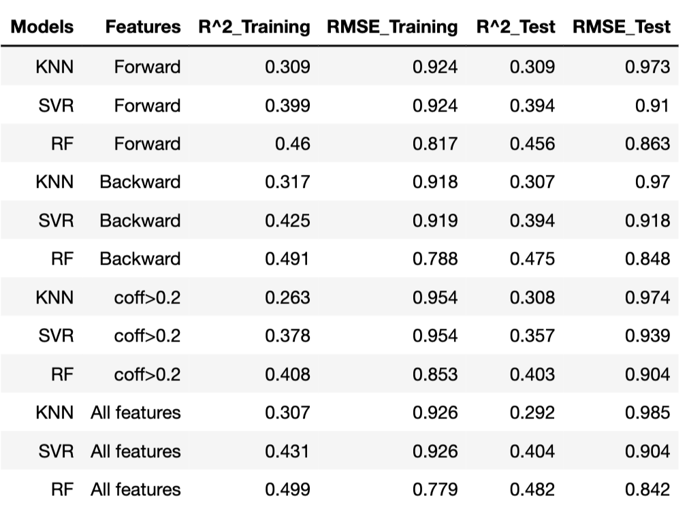
StandardScaler

Slide 21
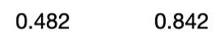
Combination model
KNN
SVR
RF
RF:

Slide 22
Thank you

